Slide 1
Bootstrap and Font Awesome
Lecturer: Ngo Huy Bien
Software Engineering Department
Faculty of Information Technology
VNUHCM - University of Science
Ho Chi Minh City, Vietnam
nhbien@fit.hcmus.edu.vn

Slide 2

Objectives
To create a web page using Bootstrap.
To add icons to a web page using Font Awesome.

Slide 3

Contents
Bootstrap
Grid System
Forms
Font Awesome

Slide 4

References

Slide 5

What is Bootstrap?
https://getbootstrap.com/
The world’s most popular front-end open source toolkit, featuring Sass variables and mixins, responsive grid system, extensive prebuilt components, and powerful JavaScript plugins.

Slide 6

Why Use Bootstrap?
Quickly design and customize responsive mobile-first sites with Bootstrap, the world’s most popular front-end open source toolkit, featuring Sass variables and mixins, responsive grid system, extensive prebuilt components, and powerful JavaScript plugins.

Slide 7

Hello Bootstrap
https://getbootstrap.com/docs/5.1/getting-started/introduction/
<!doctype html>
<html lang="en">
<head>
<!-- Required meta tags -->
<meta charset="utf-8">
<meta name="viewport" content="width=device-width, initial-scale=1">
<!-- Bootstrap CSS -->
<link href="./css/bootstrap.min.css" rel="stylesheet"> <title>Hello, Bootstrap!</title>
</head>
<body>
<h1>Hello, Bootstrap!</h1>
<!-- Optional JavaScript -->
<script src="./js/bootstrap.bundle.min.js"></script>
</body>
</html>

Slide 8
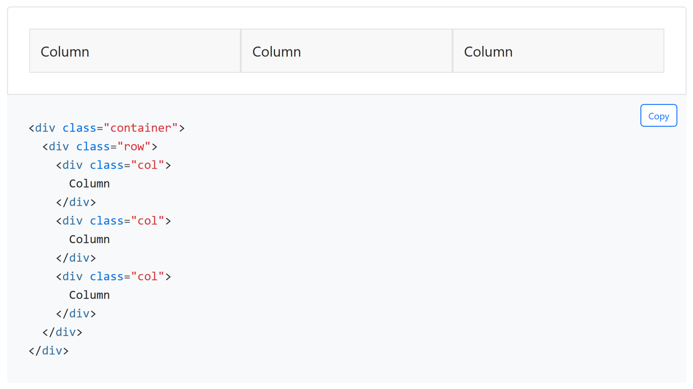
Grid System
https://getbootstrap.com/docs/5.1/layout/grid/
Bootstrap’s grid system uses a series of containers, rows, and columns to layout and align content.
It’s built with flexbox and is fully responsive.

Slide 9
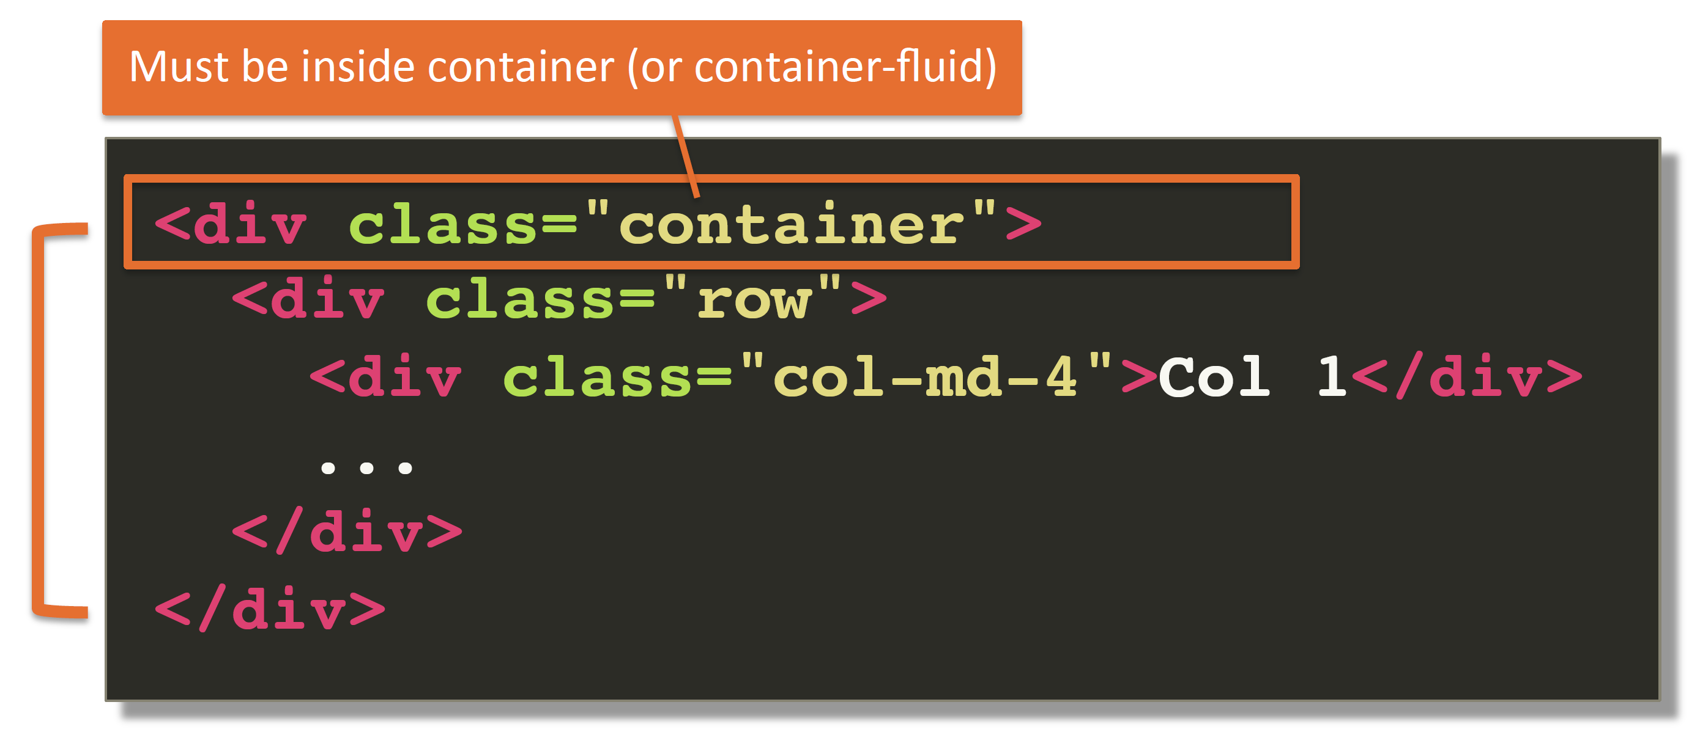
Grid System: container
The grid-based layout needs to be inside .container (or .container-fluid).

Slide 10
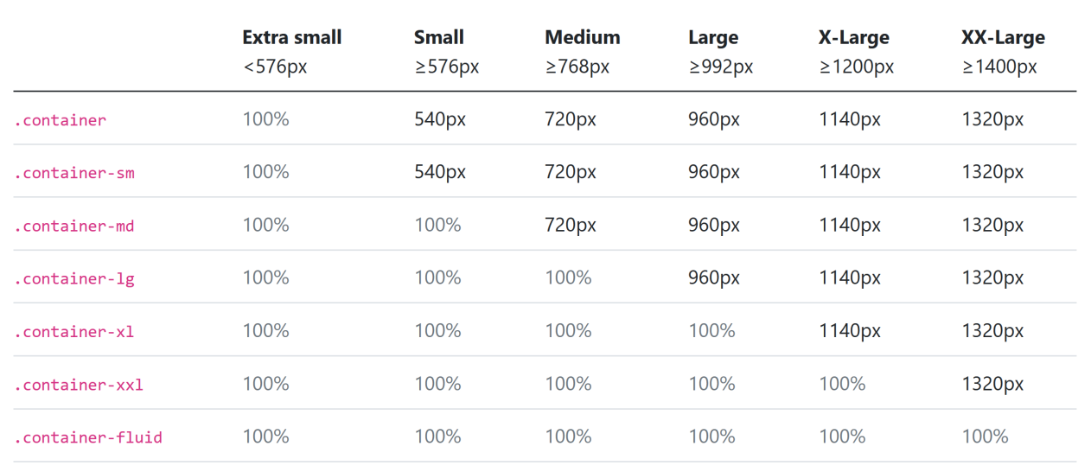
Containers
https://getbootstrap.com/docs/5.1/layout/containers/
Bootstrap comes with three different containers:
.container, which sets a max-width at each responsive breakpoint
.container-fluid, which is width: 100% at all breakpoints
.container-{breakpoint}, which is width: 100% until the specified breakpoint

Slide 11
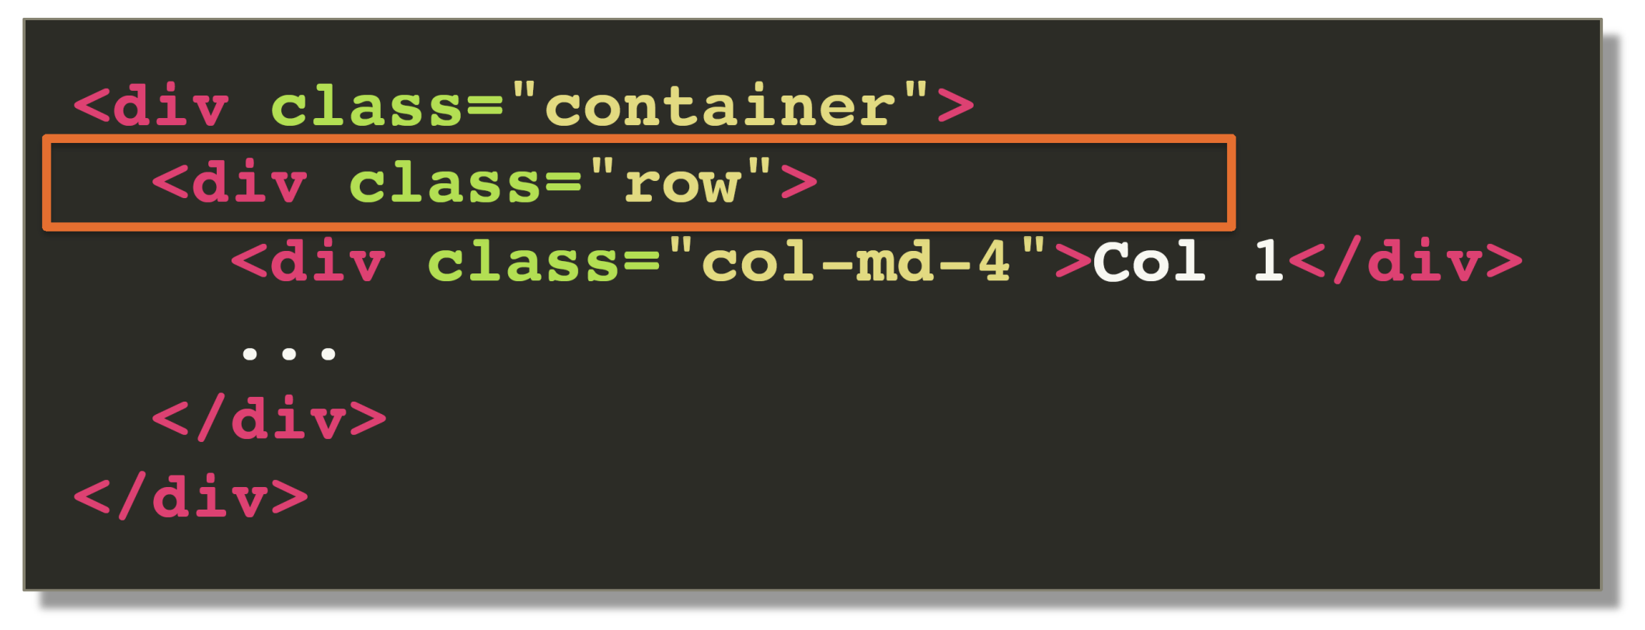
Grid System: row
All columns must be inside .row.

Slide 12
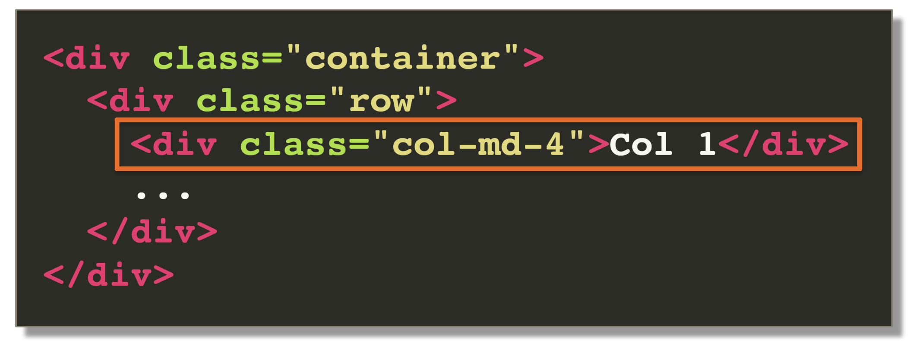
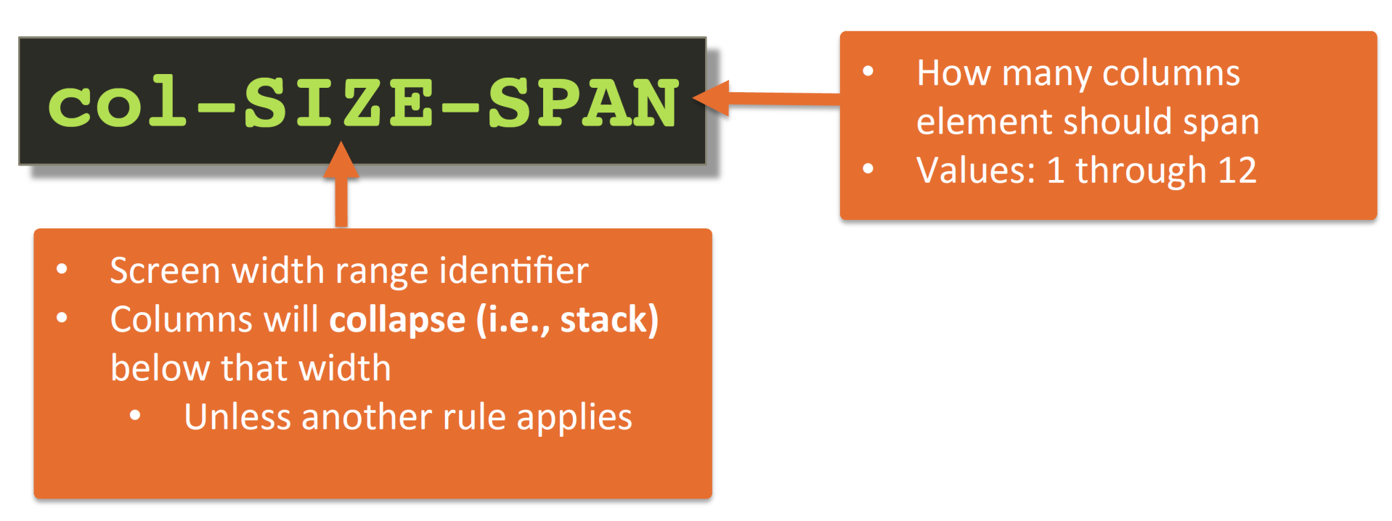
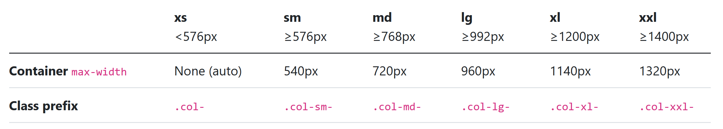
Grid System: col-
SIZE identifier identifies at which breakpoint specified column spans will be ignored and all elements willcollapse (i.e., stack).

Slide 13
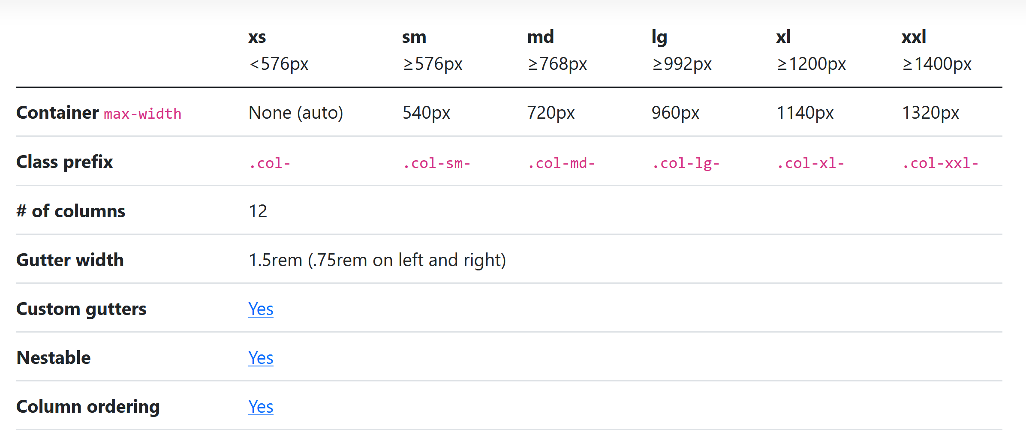
Grid System: col-xs-
If no other rules apply, specifying col-xs-… will keep that layout no matter what the size of the screen.
https://getbootstrap.com/docs/5.1/layout/grid/

Slide 14
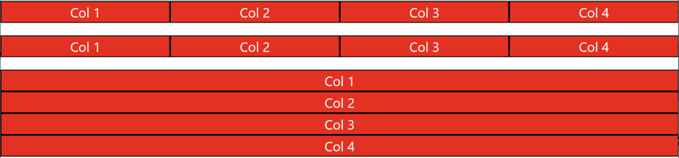
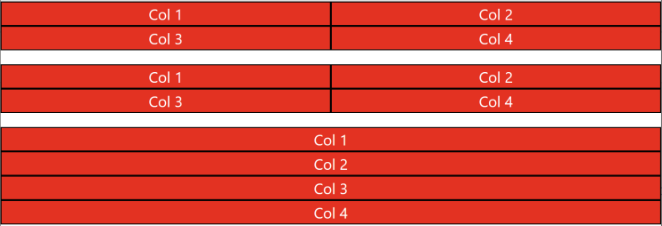
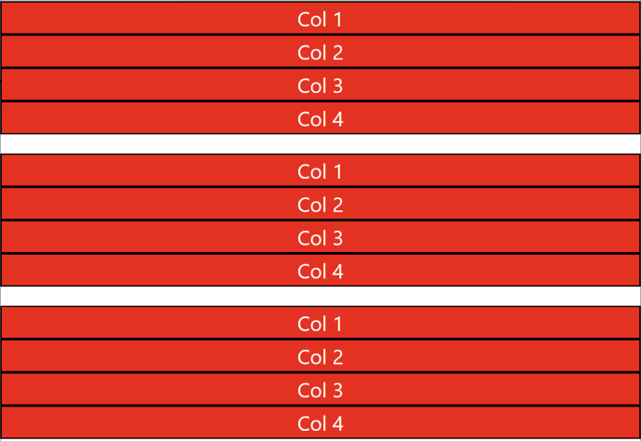
Bootstrap Grid Example
<div class="container-fluid">
<div class="row">
<div class="col-md-3 col-sm-6">Col 1</div>
<div class="col-md-3 col-sm-6">Col 2</div>
<div class="col-md-3 col-sm-6">Col 3</div>
<div class="col-md-3 col-sm-6">Col 4</div>
</div>
<div class="row">
<div class="col-md-3 col-sm-6">Col 1</div>
<div class="col-md-3 col-sm-6">Col 2</div>
<div class="col-md-3 col-sm-6">Col 3</div>
<div class="col-md-3 col-sm-6">Col 4</div>
</div>
<div class="row">
<div class="col-xs-6">Col 1</div>
<div class="col-xs-6">Col 2</div>
<div class="col-xs-6">Col 3</div>
<div class="col-xs-6">Col 4</div>
</div>
</div>

Slide 15
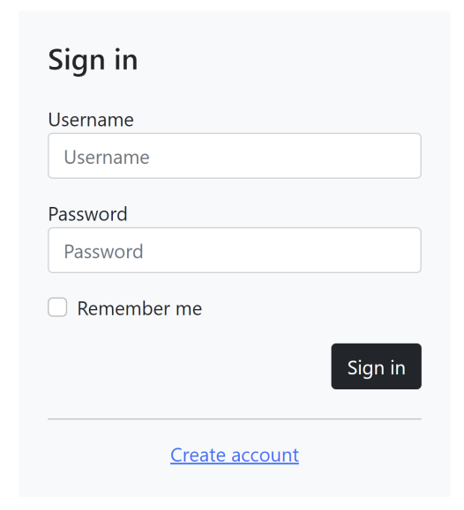
Bootstrap Form Example
https://getbootstrap.com/docs/5.1/content/reboot/#forms
<div class="container">
<div class="row">
<div class="col-md-4 offset-md-4">
<div class="login-form bg-light mt-4 p-4">
<form action="" method="" class="row g-3">
<h4>Sign in</h4>
<div class="col-12">
<label>Username</label>
<input type="text" name="username" class="form-control" placeholder="Username">
</div>
...

Slide 16
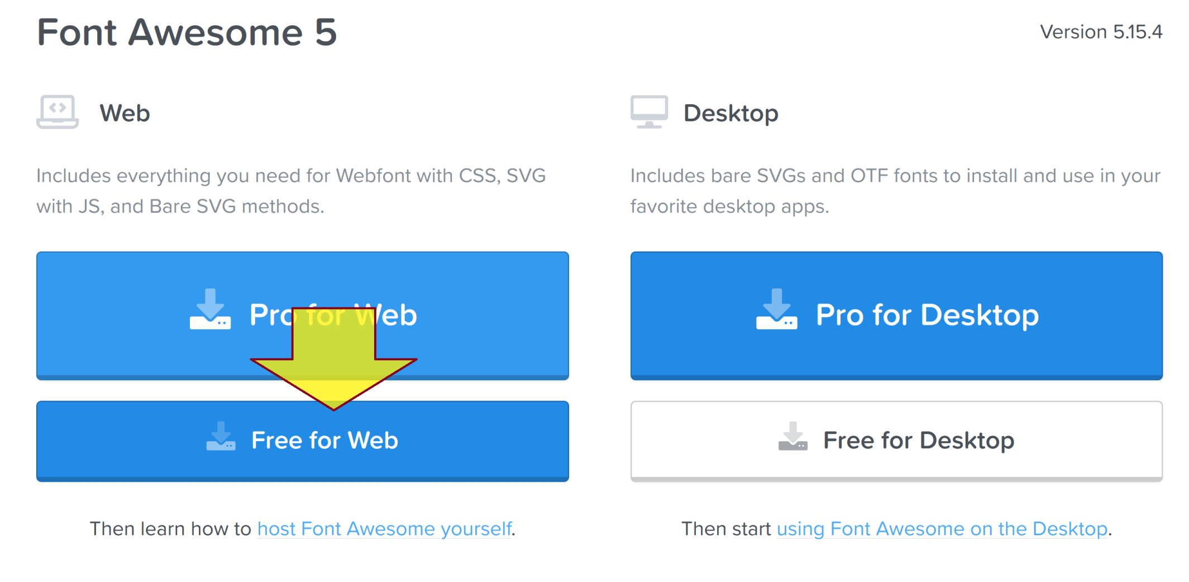
Download Font Awesome
https://fontawesome.com/download
Scroll down to the Font Awesome 5 section.

Slide 17
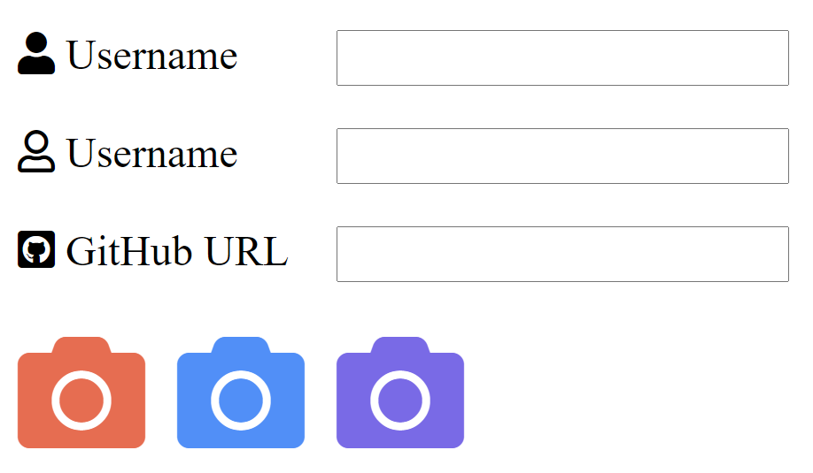
Hello Font Awesome
<head>
...
<!-- FontAwesome CSS -->
<!-- load all styles -->
<link href="./fontawesome-free-5.15.4-web/css/all.css" rel="stylesheet">
...
</head> <body>
<p>
<div style="float: left; width: 120px;">
<!-- uses solid style -->
<i class="fas fa-user"></i> Username
</div>
<input type="text">
</p>
…
</body>

Slide 18
Introduction to Sass
https://sass-lang.com/documentation
Sass (Syntactically Awesome Style Sheets) is a stylesheet language that’s compiled to CSS.
It allows you to use variables, nested rules, mixins, functions, and more, all with a fully CSS-compatible syntax.
https://sass-lang.com/install
When you install Sass on the command line, you'll be able to run the sass executable to compile .sass and .scss files to .css files.
https://getbootstrap.com/docs/5.1/customize/sass/
Learn how to theme, customize, and extend Bootstrap with Sass.

Slide 19

Further Reading
https://getbootstrap.com/docs
Panos Matsinopoulos (2020). Practical Bootstrap: Learn to Develop Responsively with One of the Most Popular CSS Frameworks. Apress.
https://fontawesome.com/v5.15/how-to-use/on-the-web/referencing-icons/basic-use

Slide 20

Thank You & See You Again

